Slide 1
Computer Vision:
Computer Vision
MATH 3439 01
April 22, 2025
Exploring CNNs and Image Recognition with PyTorch
By: Zuleyka,
Lidzy, and Jose
Notes:
Convolutional neural networks

Slide 2
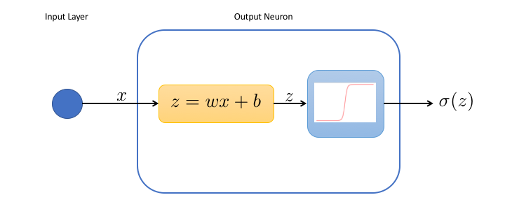
What are Neural Networks?
The most basic unit of a Neural Network are neurons.
Each neuron in a neural network performs a simple calculation, where it takes inputs, applies weights, adds a bias, and then passes the result through an activation function.
output=activation(∑(input​×weight)+bias)
Notes:
Inputs-These are the values the neuron receives. For example, if the neuron is classifying an image, the inputs could be pixel values.
Weights- Each input is multiplied by a weight. Weights control how important each input is to the final decision. A high weight means the input is important; a low weight means it's less important. Weights are learned during training.
Bias: The bias is a number added to the sum. Bias helps the neuron decide more easily when to make a decision.
Higher bias = the network is more confident in making a prediction, even with less information.
Lower bias = the network is more cautious and needs clearer evidence before making a decision.
Activation Function: After the calculation, the result is passed through an activation function (like ReLU or sigmoid). This decides whether the neuron "activates" (turns on) or not, based on the result. It adds a non-linearity, allowing the network to learn complex patterns.

Slide 3
Neural Networks
Computer Vision
MATH 3349 01 Time Location
One says, “I see ears,” another adds, “It’s got fur,” and a third decides, “Must be a cat!” A neural network works like a team to recognize patterns in data.
How They Work
Input: You feed in information, like a picture.
Hidden Layers: The network breaks it down into smaller pieces, like shapes, colors, and edges.
Output: It uses what it learned to make a guess. For example, “This is a 3” or “This is a cat.”

Slide 4
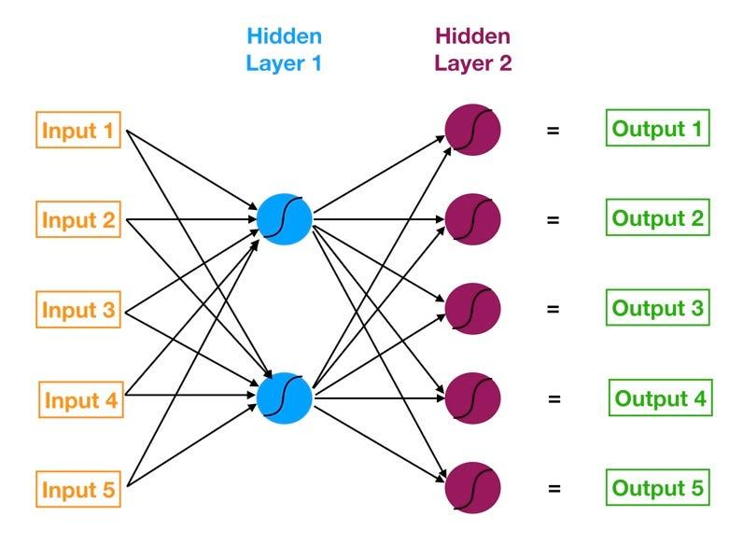
Neural Networks - How They Work
Called “hidden layers” because you don’t directly see them — you only interact with the input and output.
Why are there several?
Breaks down complexity: The more layers there are, the better the network can learn to recognize complex patterns.
Hierarchical learning: More hidden layers help the network understand data in a more detailed, layered way.
Notes:
Breaking down complexity - Imagine you're teaching someone how to identify a cat in a photo. The first layer might look for simple shapes, like edges. The next layer might look for more complex features, like eyes or ears.
Hierarchical learning - It’s like learning to read: first, you learn letters, then words, then sentences.

Slide 5
Convolutional Neural Networks - An example with the MNIST Database
For example, in a classification task with digits from 0 to 9, the output layer would have 10 neurons

Slide 6

Why Use PyTorch for Neural Networks?
Computer Vision
MATH 3349 01 Time Location
DATE
PyTorch speeds up your code by using GPU acceleration behind the scenes, allowing you to focus on building and training your models while it handles the performance improvements.
Companies like Meta, Tesla, and Microsoft, along with AI research leaders like OpenAI, use PyTorch to power their research and bring machine learning to their products.
Notes:
GPU (Graphics Processing Unit) is better for handling lots of small,repetitive calculations, like the ones needed for training a machine learning model. CPU (Central Processing Unit) is slower when it comes to many repetitive tasks

Slide 7

What is Computer Vision?
Computer Vision
MATH 3349 01 Time Location
April 22, 2025
Computer vision is a field of artificial intelligence (AI) that teaches computers how to “see” and make sense of images and videos, just like we do with our eyes and brains.
But instead of eyes, computers use pixels. And instead of a brain, they rely on neural networks, which help them understand what’s in an image, whether that’s a handwritten number, a stop sign, or even a person’s face.
Cars that detect road signs and pedestrians
Machines that use AI to read X-rays and spot diseases
Real World Scenarios

Slide 8
Why Images Need Special Treatment
Computer Vision
MATH 3349 01 Time Location
April 22, 2025
Regular Neural Network
Convolutional Neural Networks (CNNs)
In a regular neural network, each pixel is treated as a separate, individual input. For example, a 28×28 pixel image becomes a list of 784 numbers.
Images are flattened into numbers, so the 2D structure is lost
Pattern recognition is more likely to decrease.
CNNs preserve the spatial structure of the image. Instead of flattening it into a list, they look at groups of pixels together, like little windows sliding across the image, to detect patterns such as lines, edges, or textures.
Images are treated like connected visual data.
Understanding of visuals increases, along with pattern recognition.

Slide 9
Why use Convolutional Neural Networks?
Fewer Inputs: CNNs use filters to reduce the number of neurons
Shift Tolerance: They handle small pixel movements well
Pattern Detection: Great at spotting patterns and relationships
Regular Neural Networks don’t capture pixel correlations.

Slide 10
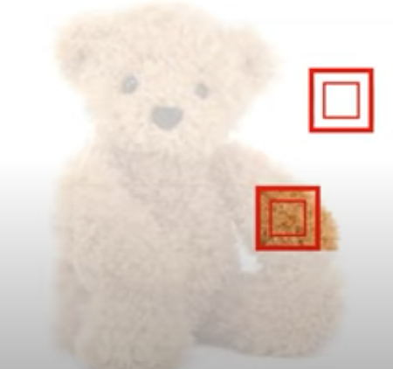

Slide 11
What are Convolutional Neural Networks?
CNNs (Convolutional Neural Networks) are a special kind of neural network made to analyze and recognize images.
How is it possible to classify an image?
Images are flattened into numbers.
Digital images are made up of small squares called pixels. Each pixel stores color and brightness information for that spot in the image.
Each pixel has three values (RGB) that control its color and brightness.
https://rgbcolorpicker.com/

Slide 12
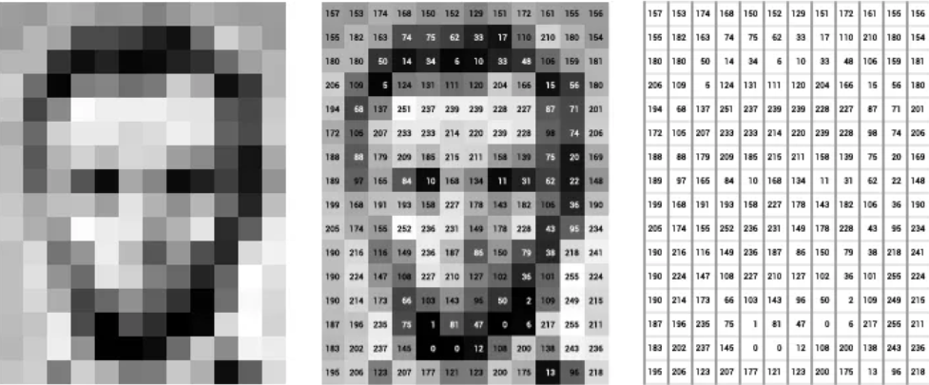
In a grayscale image, each pixel has a single value showing light intensity, ranging from black (0) to white (255).

Slide 13
What makes a CNN different from a neural network?
Convolutional layers which are the core of CNN. These layers perform a critical mathematical operation known as convolution.
This process entails the application of filters known as kernels, that move across the image to learn complex visual patterns
What are kernels?
Kernels are small matrices of numbers
They move over an image and perform a dot product (sum of products) with the pixels they cover to extract features

Slide 14
What exactly are we doing?

Slide 15
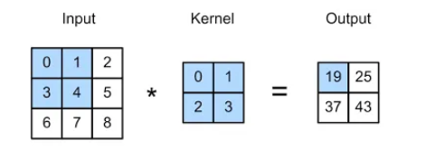
Output is called Feature Map
We start in the left corner with our input
(0*0)+(1*1)+(3*2)+(4*3)=19
Then we slice one pixel from the right and perform same operation
(1*0)+(2*1)+(4*2)+(5*3)=25
We complete the first row so we move one pixel down and start again
(3*0)+(4*1)+(6*2)+(7*3)=37
Finally we slice one pixel from the right
(4*0)+(5*1)+(7*2)+(8*3)=43

Slide 16
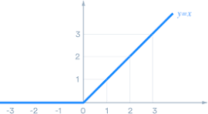
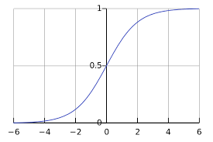
Feature Extraction Part
After each convolution, we run the feature map through an activation function
This adds non-linearity, allowing the model to learn complex patterns
ReLU
Sigmoid Function
ReLU outputs the input if it's positive; otherwise, it gives zero.
Output values between 0 and 1 mainly used for binary classification

Slide 17
Pooling layers
After activation function, pooling layers make the image smaller while keeping key features.
In this example, we have reduced the feature map from (4 x 4) to (2 x2)

Slide 18
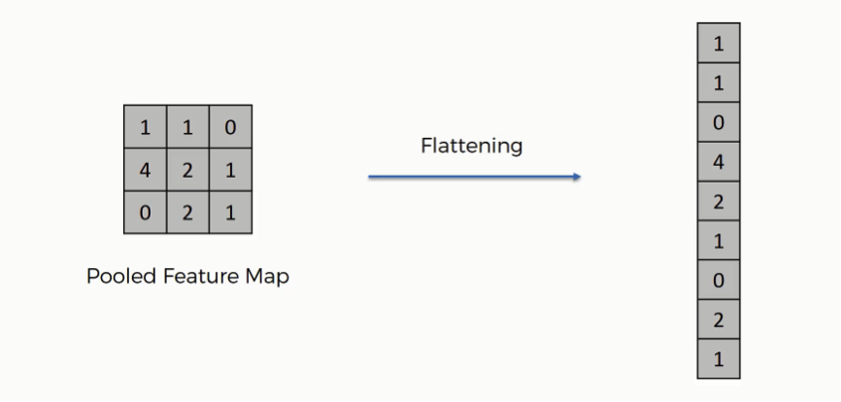
Flattening layers
After convolution and pooling, we need to prepare the data for fully connected layers
Flattening takes the 2D Feature Map and turns it into a 1D Vector
Why do we need flattening layers?
Fully Connected layers (Dense Layers) are designed to operate in 1 Dimensional data

Slide 19

Why do we need Dense Layers in CNN?
While Convolutional layers are good at detecting features in input data, dense layers are essential for integrating these features into predictions
Ex: In facial recognition, early layers detect edges and textures, while dense layers use them to recognize faces

Slide 20
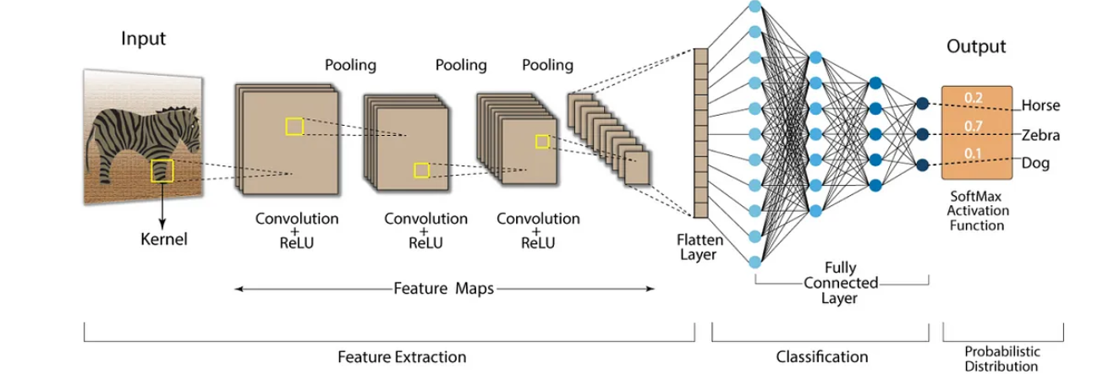

Slide 21
The SoftMax function in the output layer turns raw outputs into probabilities that add up to 1
Error is calculated in the output layer, and backpropagation adjusts the weights to improve predictions in the next round

Slide 22
Parts of a CNN
Computer Vision
MATH 3349 01 Time Location
April 22, 2025
A CNN is a special kind of neural network made for understanding images. Instead of looking at each pixel one by one, CNNs look at small groups of pixels at a time to find patterns.
Convolutional Layers:
These are like smart filters that slide across the image, picking up features like curves, edges, and textures (Think of it like magnifying glasses looking for specific details).
Pooling Layers:
Once the important patterns are found, these layers simplify things by keeping only the strongest or most important pieces of information. This makes the system faster and less likely to get confused by noise.
Flattening Layer:
At some point, all those patterns need to be turned into a list so the computer can understand them easily (Like unrolling a crumpled paper into a straight line).
Fully Connected Layers:
These take all the learned information and make the final decision, (e.g., “yes, this is a number 7” or “no, that’s not a dog”).
At first, the network might make random guesses. But every time it gets feedback, it tweaks itself to do better next time.
This learning process happens over many rounds (called epochs), like a student practicing multiple choice questions over and over until they ace the test.

Slide 23
MNIST Dataset
Name
Department Course Number Section Time Location
DATE
To teach a CNN, you need training data!
What is It?
How Are the Images Stored?
Used with CNNs
The MNIST Dataset (Modified National Institute of Standards and Technology) is a collection of 70,000 black-and-white images of handwritten digits, typically used for training image processing systems.
CNNs do especially well with MNIST because they can quickly learn to spot the curves and lines that make up each number.
Each image is 28×28 pixels, just 784 numbers per image, which makes it simple enough to start learning, but still complex enough to train a real model.

Slide 24
CNN Model with MNIST Dataset
Step 1: Importing Libraries
torch is the core library for tensors and modeling.
torch.nn lets us build the neural network.
torch.optim helps us train the model by optimizing the weights.
torchvision helps load and process image datasets like MNIST.
transforms are used to prepare images (like converting to tensors, normalizing, etc.).
import torch
import torch.nn as nn
import torch.optim as optim
import torchvision
import torchvision.transforms as transforms
from torch.utils.data import DataLoader

Slide 25
CNN Model with MNIST Dataset
Step 2: Preprocess the Images
ToTensor(): Turns each image into a PyTorch Tensor
Normalize((0.5,), (0.5,)): Scales pixel values to the range [-1,1] for better training performance. MNIST pixels originally range from 0 to 1.
(Shifting pixels to [-1, 1] balances the math inside the model, helping it learn faster and make better prediction)
transform = transforms.Compose([
transforms.ToTensor(),
transforms.Normalize((0.5,), (0.5,))
])

Slide 26
CNN Model with MNIST Dataset
train_dataset = torchvision.datasets.MNIST(root='./data', train=True, download=True, transform=transform)
test_dataset = torchvision.datasets.MNIST(root='./data', train=False, download=True, transform=transform)
train_loader = DataLoader(dataset=train_dataset, batch_size=64, shuffle=True)
test_loader = DataLoader(dataset=test_dataset, batch_size=64, shuffle=False)
Step 3: Loading the Data
train_dataset: Loads 60,000 training images
Test_dataset: Loads 10,000 test images
train_loader: Loads the data in batches of 64 images, and randomizes the order of the images for each training cycle.
Test_loader: Sends test data in batches (Not shuffled)
Shuffling helps the model generalize by seeing images in different orders!

Slide 27
CNN Model with MNIST Dataset
class CNN(nn.Module):
def __init__(self):
super(CNN, self).__init__()
self.conv1 = nn.Conv2d(1, 32, kernel_size=3, padding=1)
self.conv2 = nn.Conv2d(32, 64, kernel_size=3, padding=1)
self.pool = nn.MaxPool2d(2, 2)
self.fc1 = nn.Linear(64 * 7 * 7, 128)
self.fc2 = nn.Linear(128, 10)
def forward(self, x):
x = self.pool(nn.functional.relu(self.conv1(x)))
x = self.pool(nn.functional.relu(self.conv2(x)))
x = x.view(-1, 64 * 7 * 7)
x = nn.functional.relu(self.fc1(x))
x = self.fc2(x)
return x
Step 4: Define the Model
Conv2d: Applies filters to extract features from the image (like edges or shapes)
MaxPool2d: Shrinks the image and highlights key features
ReLU: Adds non-linearity so the model can learn complex patterns
Linear: Fully connected layers that make the final predictions
forward(): Defines how data flows through the model

Slide 28
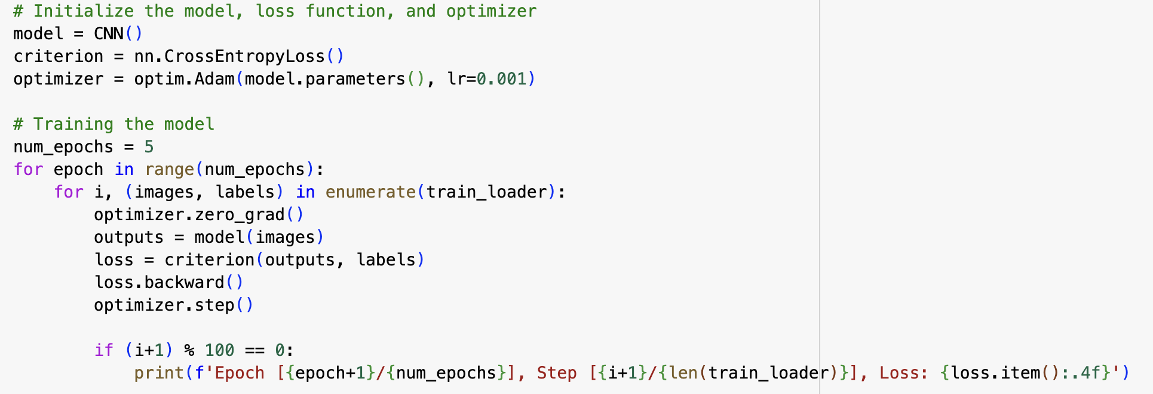
CNN Model with MNIST Dataset
Step 5: Train the Model
CrossEntropyLoss: Measures how far off the model's predictions are from the true labels.
Adam: Optimizer that updates model weights based on the loss.
Each epoch means one full pass through the training data.
The model makes a prediction → calculates the loss → adjusts its weights (learning).

Slide 29
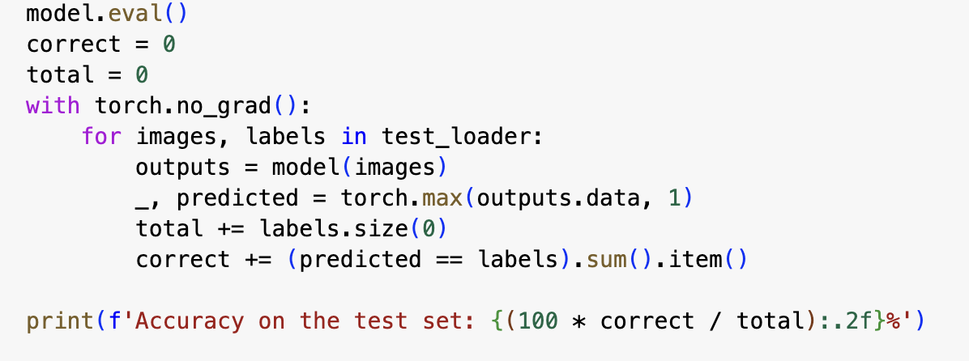
CNN Model with MNIST Dataset
Step 5: Evaluate the Model
modelEval: Tells PyTorch we’re testing, not training
with torch.no_grad(): Disables gradient calculation during testing (saves memory and speed).
_, predicted: Gets the class with the highest score for each image.
correct +=: Checks how many predictions match the true labels.

Slide 30
Thank You!
Any questions?

Slide 31
https://www.learnpytorch.io/00_pytorch_fundamentals/
https://www.youtube.com/watch?v=oBklltKXtDE
https://www.nvidia.com/en-us/glossary/pytorch/
https://medium.com/thedeephub/convolutional-neural-networks-a-comprehensive-guide-5cc0b5eae175
https://www.youtube.com/watch?v=HGwBXDKFk9I
Works cited!

